Slide 2
Course Objectives
Know how to handle a suspected case
Know how to care for a recognized trafficked person referred to you
Session Objectives
Understand human trafficking
Identify major health consequences of trafficking
Recognise key features of trauma-informed care
Recognize techniques for provider and patient safety
Understand the benefits of specialized care approaches
Identify possibilities and limitations of role of health care providers

Slide 3
CORE MODULE
What is Trafficking in Persons?

Slide 4
Session Objective
Understand human trafficking

Slide 5
Quiz: True / False
All victims of trafficking are abducted
Those who migrate legally can be victims of trafficking
All people are trafficked for the purpose of sexual exploitation
This country does not have a human trafficking law
Some victims of trafficking are men
Trafficking is a problem worldwide
This country does not have shelter for victims of trafficking

Slide 6
Discussion
In your opinion, what is human trafficking?

Slide 7
How does trafficking work?
video

Slide 8
The Definition of Trafficking
“…recruitment, transportation, transfer, harbouring or receipt of persons,
by means of the threat or use of force or other forms of coercion, of abduction, of fraud, of deception, of the abuse of power or of a position of vulnerability or of the giving or receiving of payments or benefits to achieve the consent of a person having control over another person for the purpose of exploitation.
Exploitation shall include, at a minimum, the exploitation of the prostitution of others or other forms of sexual exploitation, forced labour or services, slavery or practices similar to slavery, servitude or the removal of organs;”
UN Convention against Transnational Organized Crime,
Protocol to Prevent, Suppress and Punish Trafficking in Persons 2000

Slide 9
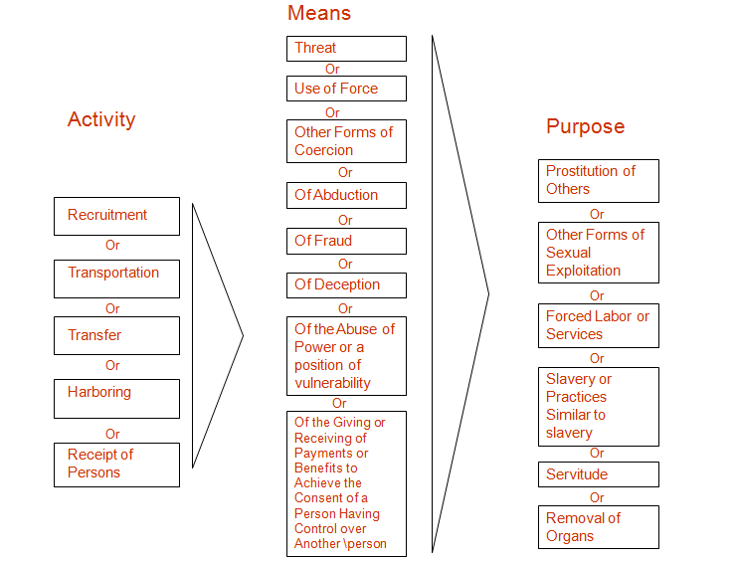
The Definition of Trafficking
IOM Counter Trafficking Training Modules, 2006

Slide 10
The Definition of Trafficking
Activity/process: recruitment, transportation, transfer, harbouring, or receipt
Recruitment:
Word of mouth, personal contacts, trusted friends or family
Newspaper or Internet advertisements, social networking websites
Often using deceit, fraud or coercion
Transportation:
Origin, transit and destination communities
Legal or illegal border crossings, within a country
Travel by land, air or sea
Often accompanied (documents retained)

Slide 11
Coercion and Abuse
Excessive working hours
Freedom of movement totally denied / partially denied
Verbal / psychological abuse
Not allowed to keep earned money, debt
Sexual abuse and rape
Forced substance abuse
Deprivation of adequate food / water
Lack of access to health care

Slide 12
Types of Human Trafficking
Forced begging
Forced labor
Sexual exploitation
Domestic servitude
Forced, underage marriage

Slide 13
Trafficked persons can be:
male, female
adult, children
foreigners, nationals
a stranger, family, friend
migrant with legal migration status
migrant with illegal migration status / no documents
smuggled migrant
Remember: Not all trafficking occurs in the same way. The local context and specific situation will determine who is most at risk and how they are exploited.

Slide 14
Why doesn’t the victim leave?
Restricted movement: kept in a restricted area to limit contact with the community and to extract the maximum work
Passports and documents are taken: fear of migration and law enforcement authorities
Violence and abuse: physical and psychological abuse, exhausting hours, poor conditions, lack of access to health services, witnessing violence

Slide 15
What is trafficking in persons?
A criminal act
A human rights violation
A form of exploitation
An act of violence

Slide 16
Conclusions
There is a need to engage the health sector to help identify and treat trafficked persons

Slide 17
Check your answers
All victims of trafficking are abducted
Those who migrate legally can be victims of trafficking
All people are trafficked for the purpose of sexual exploitation
This country does not have a human trafficking law
Some victims of trafficking are men
Trafficking is a problem worldwide
This country does not have shelter for victims of trafficking
False
True
False
True / False
True
True
True / False

Slide 18
SESSION END
What is Trafficking in Persons?

